Slide 1
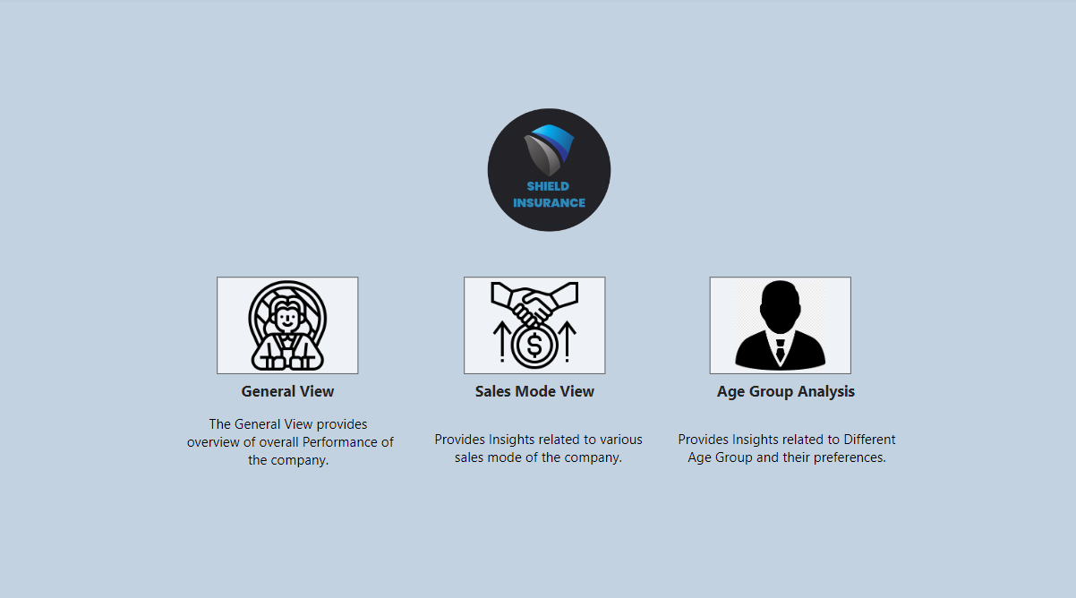


Slide 2
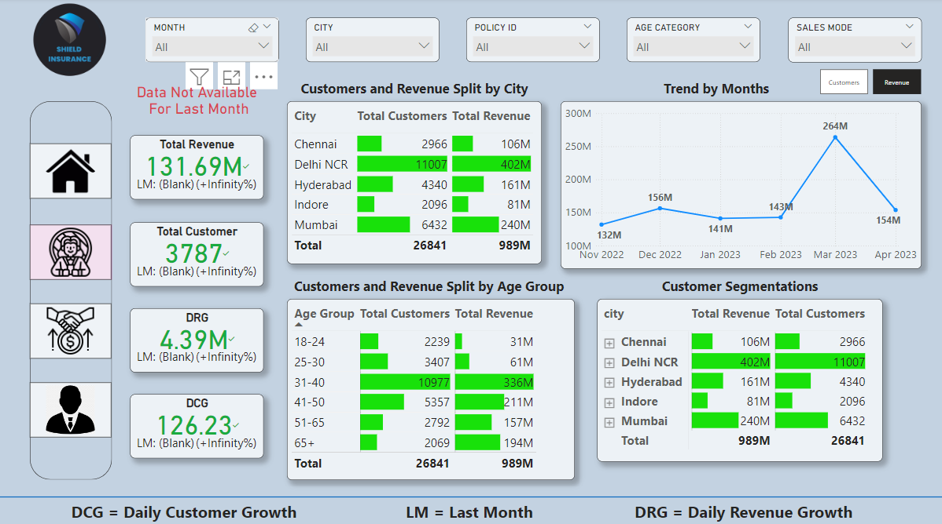

Slide 3
Customers and Revenue by City
Delhi NCR is the best performing city (11,007 customers, 402M revenue).
Indore is the worst performing city (2,096 customers, 81M revenue).
Emphasize Delhi NCR's dominance in both customer acquisition and revenue.
On the other cities Chennai, Hyderabad, Indore and Mumbai should improve their strategies.

Slide 4
Customer and Revenue by Age Group
31-40 age group is the highest contributor (10,977 customers, 336M revenue).
65+ age group is contributing lowest customers 2,069.
18-24 age group is contributing lowest revenue 31M.
The working-age group drives the majority of revenue, an important segment for future strategies.

Slide 5
Revenue Trends by Month
Line graph showing monthly revenue from Nov 2022 to Apr 2023.
Emphasize the spike in March 2023 to 264M and the decline to 154M in April 2023.
Shield Insurance should identify the factors contributing to the March 2023 spike and why April dropped.

Slide 6
Customers Trends by Month
Line graph showing customers trend from Nov 2022 to Apr 2023.
Emphasize the spike in March 2023 to 7.1K and the decline to 4.1K in April 2023.
Shield Insurance should identify the factors contributing to the March 2023 spike and why April dropped.

Slide 7
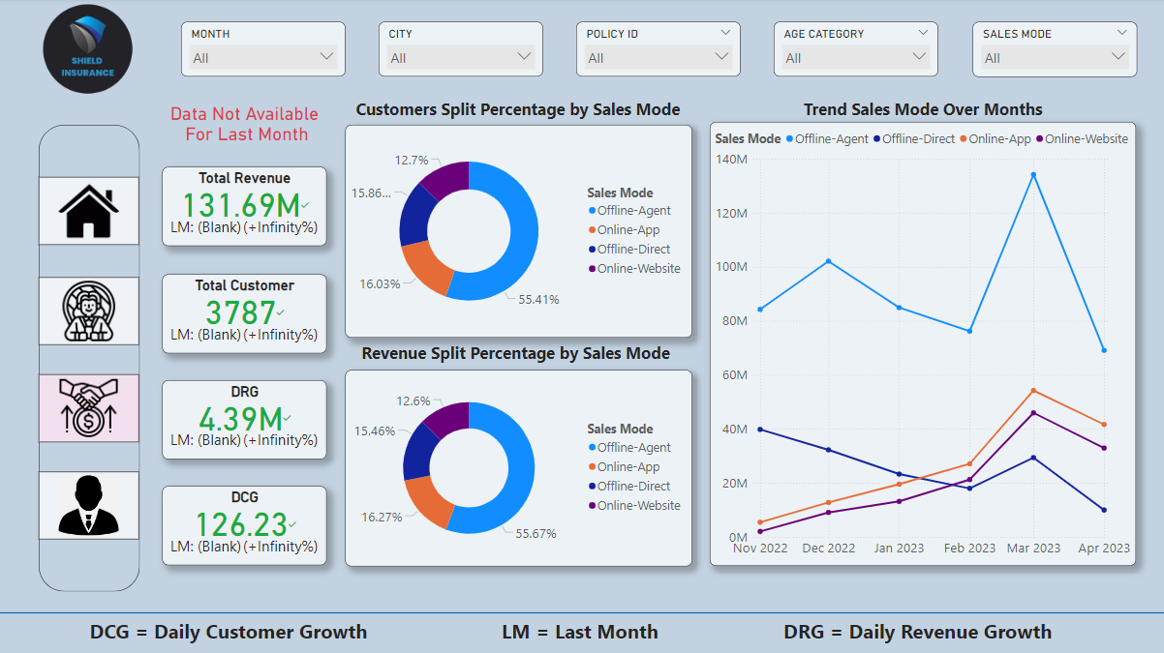

Slide 8
Customer and Revenue by Sales Mode
Customers :
The Offline-Agent mode accounts for 55.41% of customers, followed by:
Online-App: 16.03%, Offline-Direct: 15.86%, Online-Website: 12.7%.
Revenue :
Offline-Agent also leads with 55.67% of revenue, followed by:
Online-App: 16.27%, Offline-Direct: 15.46%, Online-Website: 12.6%
The Offline-Agent channel dominates both customer acquisition and revenue generation, indicating that traditional sales methods are still crucial for the business.

Slide 9
Revenue Trends by Sales Mode Over Time
Offline-Agent has the highest revenue with a sharp peak in Mar 2023.
The Online-App and Online-Website channels show steady growth but contribute less overall compared to Offline-Agent.
The Offline-Agent channel experienced significant growth in March, while the online sales modes (app and website) show gradual growth, potentially indicating an area for further digital expansion.

Slide 10
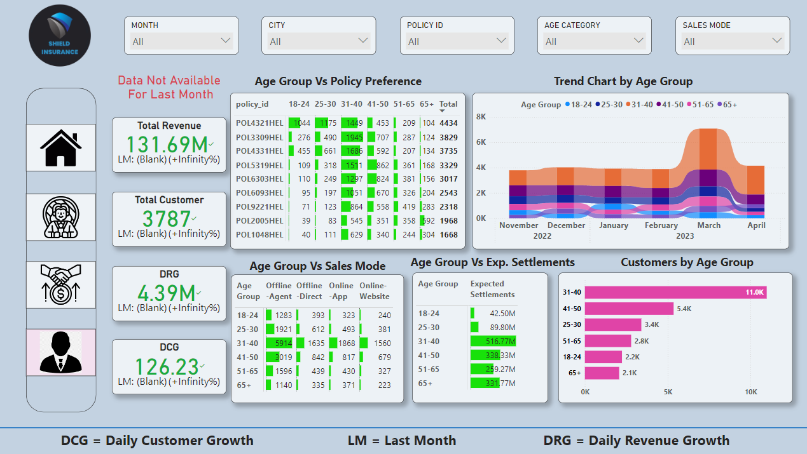

Slide 11
Age Group Vs Policy Preference
POL4321HEL has the highest number of customers (4,434), especially among the 31-40 age group.
Younger customers (18-24) prefer POL4321HEL.
Older customers (65+) prefer POL2005HEL.
POL1048HEL has the lowest number of customers (1,668).

Slide 12
Sales Mode by Age Group
Offline-Agent sales dominate across all age groups, especially for 31-40 (5,914) and 41-50 (3,019).
Online (Website and App) sales are significantly lower across all age groups, suggesting room for digital sales growth, especially with younger demographics like 18-24 and 25-30.
Offline-direct sales are also low despite of good performance of Offline-Agent performance.

Slide 13
Customer Breakdown by Age Group
31-40 age group dominates with 11K customers.
41-50 age group follows with 5.4K customers.
Smaller customer bases for 18-24 and 65+ offer growth opportunities.

Slide 14
Age Group vs. Expected Settlements
31-40 group expected settlements: $516.7M.
41-50 group: $338.33M.
51-60 group: $259.27M.
65+ group: $331.77M.
Target younger and older demographics to balance risk and growth.

Slide 15
Trend Chart by Age Group
Spike in March 2023 across all age groups followed by a dip in April.
If a marketing or policy campaign ran in March, this spike could validate its success.

Slide 16
Thanks for watching

